Slide 1
CS 408
Computer Networks
Chapter 14: Data Link Control

Slide 2
Announcements
Midterm: November 18, 2019, Monday, 8:40 – 10:30
  Places:
    FASS 1096 if (lastName >= “Akdağ" && lastName <= “Berksöz")
    FASS 1097 if (lastName >= “Bilge" && lastName <= “Deveci")
    FASS G062 if (lastName >= “Duman" && lastName <= "Süslü")
    FASS 1098 if (lastName >= “Şencan" && lastName <= “Yücel")
Exam will be closed book, closed notes
  calculators are allowed
  you are responsible all topics I covered in the class even if some of them are not in the book (I sometimes used other books) and not in the ppt files (I sometimes used board and showed applications on the computer)
    I prepared some handouts for the topics that I covered from other books (available at SUCourse under "resources") but I do not promise any completeness
    There really are some parts that I only covered on the board

Slide 3
Flow Control
In Data Link Layer, we deal with issues related to point to point links
  Flow control is one of these issues
Flow control is needed since the sending entity should not overwhelm the receiving entity
  Recipient needs some time to process incoming packets
  If sender sends faster than recipient processes, then buffer overflow occurs
    flow control prevents buffer overflow

Slide 4
Performance Metrics and Delays (Section 5.3)
Transmission time (delay)
  Time taken to emit all bits into medium
Propagation time (delay)
  Time for a bit to traverse the link
Processing time (delay)
  time spent at the recipient or intermediate node for processing
Queuing time (delay)
  waiting time at the queue to be sent out

Slide 5
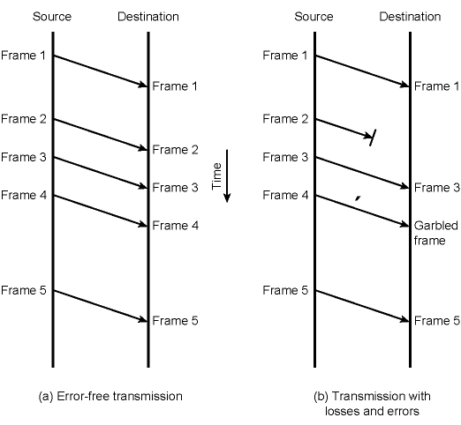
Model of Frame Transmission
propagation time
transmission time

Slide 6
Stop and Wait Flow Control
Source transmits frame
Destination receives frame and replies with acknowledgement (ACK)
Source waits for ACK before sending next frame
Destination can stop flow by not sending ACK
Works well for large frames
Inefficient for smaller frames

Slide 7
Stop and Wait Flow Control
However, generally large block of data split into small frames
  Called “Fragmentation”
  Advantages are
    Limited buffer size at receiver
    Errors detected sooner (when whole frame received)
      On error, retransmission of smaller frames is needed
    Prevents one station occupying medium for long periods
Channel Utilization is higher when
  the transmission time is longer than the propagation time
  frame length is larger than the bit length of the link
  actually last two expressions mean the same
  see the derivations on board
Amount of bits sent during propagation time

Slide 8
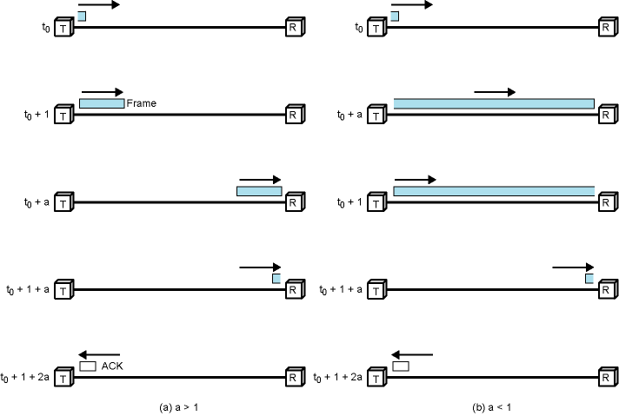
Stop and Wait Link Utilization -
Details are on the board
t₀ + T
t₀ + D
t₀ + D
t₀ + T
t₀ +T+D
t₀ +T+D
t₀ +T+2D
t₀ +T+2D
D> T
D< T
propagation time = D, transmission time = T

Slide 9
Sliding Window Flow Control
The problem of “Stop and Wait” is not able to send multiple packets
Sliding Window Protocol allows multiple frames to be in transit
Receiver has buffer of W (called window size) frames
Transmitter can send up to W frames without ACK
Each frame is numbered
  Sequence number bounded by size of the sequence number field (k bits)
  thus frames are numbered modulo 2^{k} (0 … 2^{k}-1)
ACK includes number of next frame expected

Slide 10
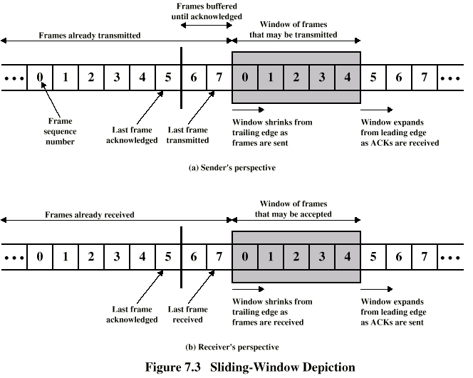
Sliding Window Flow Control
(W = 7, k=3)

Slide 11
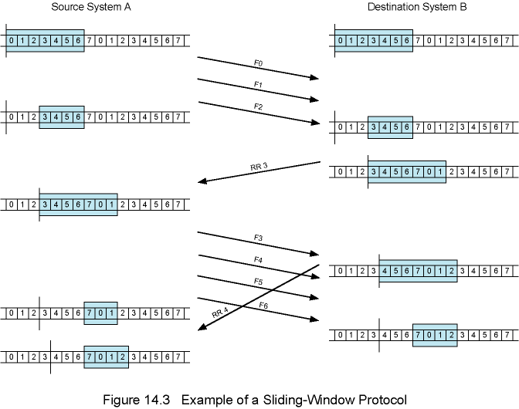
Example of a Sliding Window Protocol (W = 7)

Slide 12
Sliding Window Enhancements in Implementation
Receiver can acknowledge frames without permitting further transmission (Receive Not Ready)
  Must send a normal acknowledgement to resume
If the link is duplex, use piggybacking
  Send data and ack together in one frame
    frame has both data and ack fields
  If no data to send, use acknowledgement frame
  If data but no acknowledgement to send, send last acknowledgement number again

Slide 13
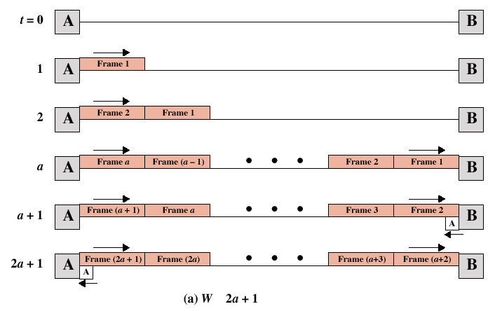
Sliding Windows Performance - 1
two cases: W >= 2a+1 and W < 2a+1, where a=D/T
details are on board
T
2T
D
D+T
2D+T
≥
( W.T ≥ 2D+T )

Slide 14
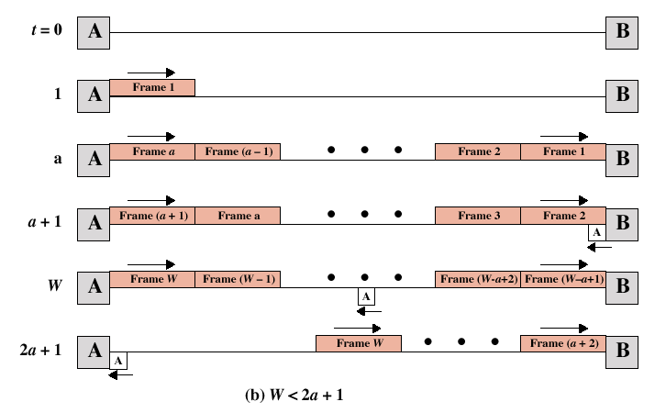
Sliding Windows Performance - 2
T
D
D+T
W.T
2D+T
( W.T < 2D+T )

Slide 15
END OF MIDTERM EXAM
The rest of this ppt file is not in the midterm exam coverage

Slide 16
Error Detection and Control
So far we have seen flow control mechanisms where frames are transmitted without errors
  in real life any transmission facility may introduce errors
So we have to
  detect errors
  if possible, correct errors (not in the scope of CS 408)
  adopt flow control algorithms such that erroneous frames are retransmitted

Slide 17
Types of Errors
Single bit errors
  isolated errors
  affects (flips) one bit, nearby bits are not altered
  not so common in real life
Burst errors
  a sequence of bits are affected
  most common case
  a burst error of length B is a contiguous sequence of B bits in which the first and the last and some intermediate bits are erroneously flipped.
    not necessarily all bits between the first and the last one

Slide 18
Error Detection
Additional bits added by transmitter as error detection code
  receiver checks this code
Parity
  single bit added to the end of the data
  Value of parity bit is such that data and parity have even (even parity) or odd (odd parity) number of ones
  Even number of bit errors goes undetected
    thus not so useful

Slide 19
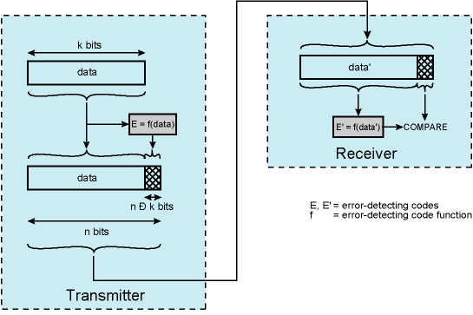
Error Detection Process using Cyclic Redundancy Check
F=
F’=
-

Slide 20
Cyclic Redundancy Check (CRC)
For a data block of k bits, transmitter generates n-k bit frame check sequence (FCS) and appends it to the end of the data bits
Transmits n bits, which is exactly divisible by some number (generator)
  the length of the generator is n-k+1 and first and last bits are 1
Receiver divides the received frame by generator
  If no remainder, assume no error
Division is binary division (not the same as integer or real division)
See board for the math details and example

Slide 21
Cyclic Redundancy Check (CRC)
Standard CRCs (generators are standard)
  checks all single, double and odd number of errors
  checks all burst errors with length less than or equal to the length of FCS (n-k bits)
  checks most of the burst errors of longer length
    for bursts of length n-k+1 (length of generator), probability of an undetected error is 1/2^{n-k-1}
    for longer bursts, probability of an undetected error is 1/2^{n-k}

Slide 22
Error Control
Actions to be taken against
  Lost frames
  Damaged frames
Automatic repeat request (ARQ) mechanism components
  Error detection
  Positive acknowledgment
  Retransmission after timeout
  Negative acknowledgement and retransmission

Slide 23
Automatic Repeat Request (ARQ)
Stop-and-wait ARQ
Go-back-N ARQ
Selective-reject (selective retransmission) ARQ

Slide 24
Stop and Wait ARQ
Source transmits single frame
Wait for ACK
If received frame is damaged, discard it
  If transmitter receives no ACK within timeout, retransmits
If ACK damaged,transmitter will not recognize it
  Transmitter will retransmit after timeout
  Receiver gets two copies of frame, but disregards one of them
  Use ACK₀ and ACK₁
    ACK_{i} means “I am ready to receive frame i”

Slide 25
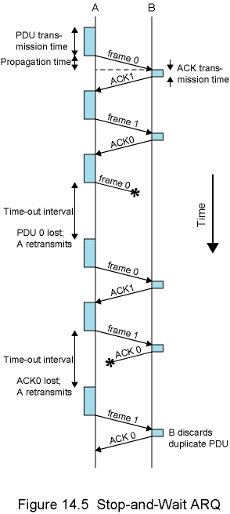
Stop-and-Wait ARQ –
Example

Slide 26
Stop and Wait - Pros and Cons
Simple
Inefficient

Slide 27
Go-Back-N ARQ
Based on sliding window
If no error, ACK as usual with next frame expected
  ACK_{i} means “I am ready to receive frame i” and “I received all frames between i (not included) and my previous ack”
Sender uses window to control the number of unacknowledged frames
If error, reply with rejection (negative ack)
  Discard that frame and all future frames until the frame in error is received correctly
  Transmitter must go back and retransmit that frame and all subsequent frames

Slide 28
Go-Back-N ARQ -
Damaged Frame
Receiver detects error in frame i
Receiver sends “reject i”
Transmitter gets “reject i”
Transmitter retransmits frame i and all subsequent frames

Slide 29
Go-Back-N ARQ - Lost Frame (1)
Frame i lost
Transmitter sends frame i+1
Receiver gets frame i+1 out of sequence
Receiver sends “reject i”
Transmitter goes back to frame i and retransmits it and all subsequent frames

Slide 30
Go-Back-N ARQ- Lost Frame (2)
Frame i lost and no additional frame sent
Receiver gets nothing and returns neither acknowledgment nor rejection
  This is kind of a deadlock situation that needs to be resolved
Transmitter times out and sends acknowledgment frame with P bit set to 1 (this is actually a command for ack request)
  Receiver interprets this as an ack request command which it acknowledges with the number of the next frame it expects (i )
Transmitter then retransmits frame i

Slide 31
Go-Back-N ARQ- Damaged/Lost Acknowledgment
Receiver gets frame i and sends acknowledgment (i +1) which is lost
Acknowledgments are cumulative, so next acknowledgement (i +n) may arrive before transmitter times out on frame i
  ==> NO PROBLEM
If transmitter times out, it sends acknowledgment request with P bit set, as before

Slide 32
Go-Back-N ARQ- Damaged Rejection
As in lost frame (2)
  sender asks the receiver the last frame received and continue by retransmitting next frame

Slide 33
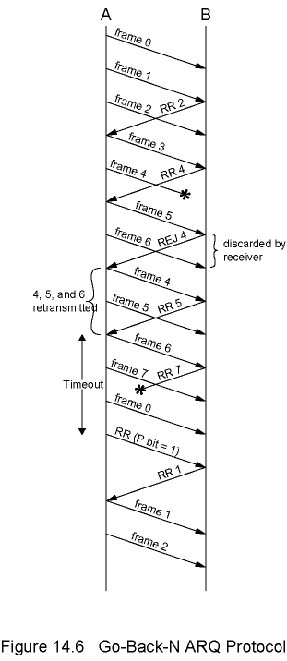
Go-Back-N ARQ -
Example (k=3, i.e. frame numbering is modulo 8)
RR means Receive Ready i.e. ack message

Slide 34
Selective Reject
Also called selective retransmission
Only rejected frames are retransmitted
Subsequent frames are accepted by the receiver and buffered
Minimizes retransmissions
Receiver must maintain large enough buffer
Complex implementation

Slide 35
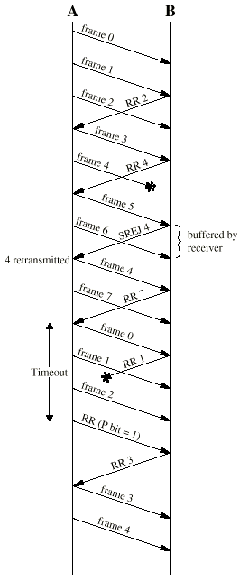
Selective Reject -
Example (k=3, i.e. frame numbering is modulo 8)

Slide 36
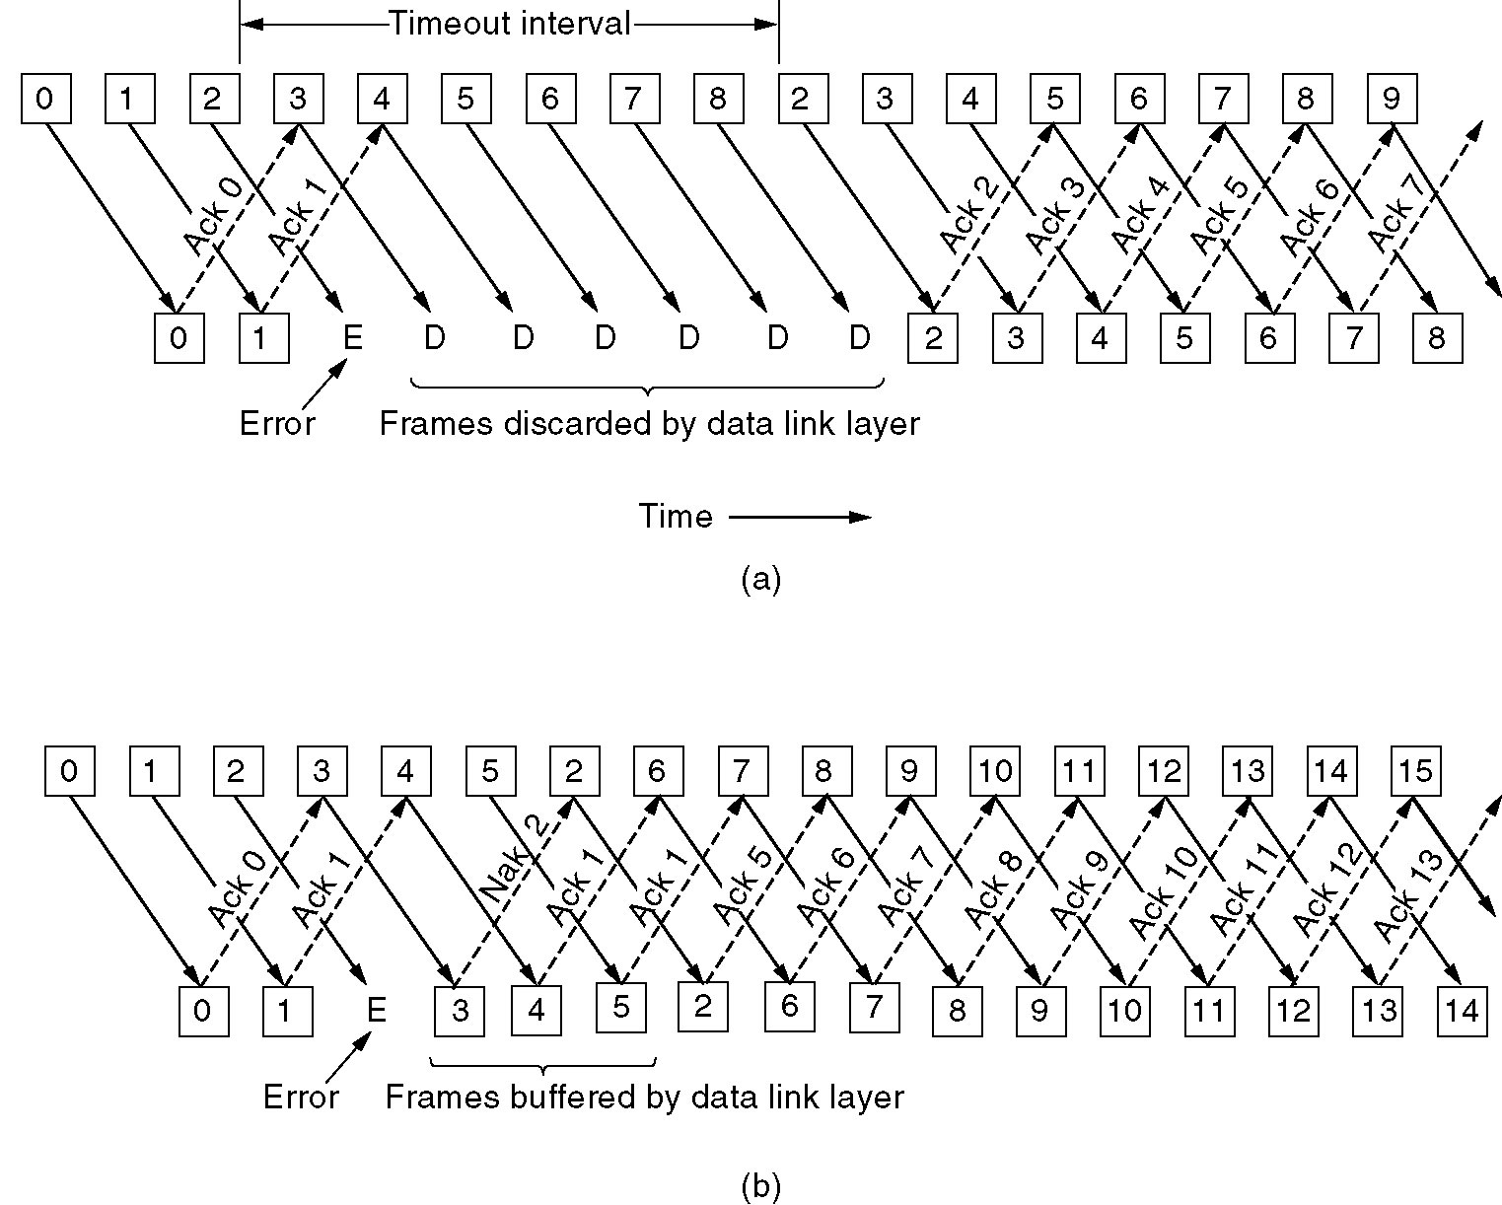
Issues
RR with P=1 (ack request) is from HDLC standard
  pure protocol just have retransmissions after timeout
    as explained in Tanenbaum

Slide 37
Issues – Window Size
Given n-bit sequence numbers, what is Max window size?
  go-back-n ARQ → 2^{n}-1
    Why?
    what about receiver’s window size?
      It is 1, why?
  selective-reject(repeat) → 2^{n-1} = 2^{n}/2
    Why?
See the reasons on the board

Slide 38
Issues – Buffer Size
Go-back-n ARQ
  sender needs to keep a buffer equal to window size
    for possible retransmissions
  receiver does not need any buffer (for flow/error control)
    why?
Selective reject
  sender needs to keep a buffer of window size for retransmissions
  receiver keeps a buffer equal to window size

Slide 39
Issues - Performance
Notes on board
Appendix at the end of Chapter 14
  selective reject ARQ is not in the book

Slide 40
High Level Data Link Control
HDLC
ISO Standard
Basis for some other DLL protocols

Slide 41
HDLC Station Types
Primary station
  Controls operation of link
  Frames issued are called commands
Secondary station
  Under control of primary station
  Frames issued called responses
Combined station
  May issue commands and responses

Slide 42
HDLC Link Configurations
Unbalanced
  One primary and one or more secondary stations
  Supports full duplex and half duplex
Balanced
  Two combined stations
  Supports full duplex and half duplex

Slide 43
HDLC Transfer Modes (1)
Normal Response Mode (NRM)
  Unbalanced configuration
  Primary initiates transfer to secondary
  Secondary may only transmit data in response to command from primary
  Terminal-host communication
    Host computer as primary
    Terminals as secondary
  not so common nowadays

Slide 44
HDLC Transfer Modes (2)
Asynchronous Balanced Mode (ABM)
  Balanced configuration
  Either station may initiate transmission without receiving permission
  Most widely used

Slide 45
Frame Structure
All transmissions in frames
Single frame format for all data and control exchanges

Slide 46
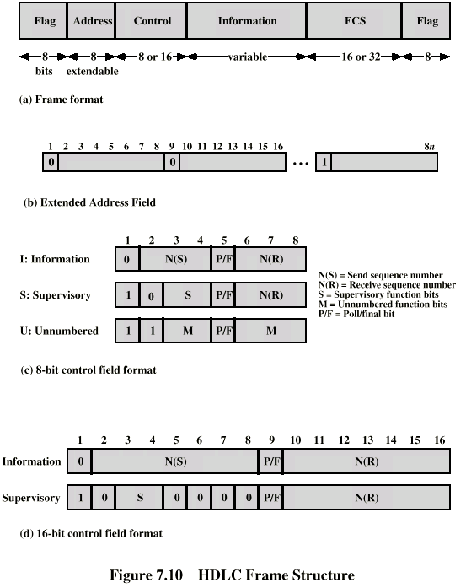
Frame Structure Diagram

Slide 47
Flag Fields
Delimit frame at both ends
01111110
Receiver hunts for flag sequence to synchronize
Bit stuffing used to avoid confusion with data containing 01111110
  0 inserted after every sequence of five 1s
  If receiver detects five 1s after a 0 it checks next bit
    If 0, it is deleted
    If 1 and seventh bit is 0, accept as flag
  If sixth and seventh bits 1, sender is indicating abort

Slide 48
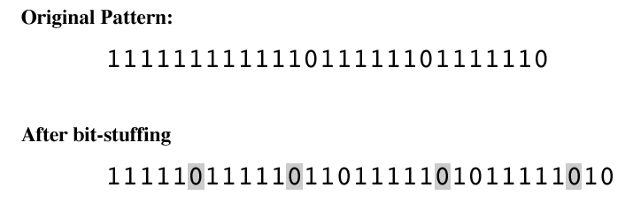
Bit Stuffing Example

Slide 49
Address Field
Identifies secondary station that sent or will receive frame
Usually 8 bits long (but 7 bits are effective)
May be extended to multiples of 7 bits with prior agreement
  leftmost bit of each octet indicates that it is the last octet (1) or not (0)

Slide 50
Frame Types
Information frame- data to be transmitted to user
  Acknowledgment is piggybacked on information frames (only for positive acknowledgment)
Supervisory frame – ARQ messages (RR/RNR/REJ/SREJ) when piggybacking not used (actually only RR can be piggybacked; for the other, we need Supervisory frames)
Unnumbered frame – supplementary link control functions. For examples,
  setting the modes
  disconnect
Control field is different for each frame type

Slide 51
Control Field Diagram

Slide 52
Poll/Final Bit
Use of this bit depends on context. A typical use is below.
Command frame
  P bit set to 1 to solicit (poll) supervisory frame from peer
Response frame
  F bit set to 1 to indicate response to soliciting command

Slide 53
Information Field
Only in information and some unnumbered frames
Must contain integral number of octets
Variable length

Slide 54
Frame Check Sequence Field
FCS
Error detection
16 bit CRC
Optional 32 bit CRC

Slide 55
HDLC Operation
Exchange of information, supervisory and unnumbered frames
Three phases
  Initialization
  Data transfer
  Disconnect

Slide 56
Initialization
Issue one of six set-mode commands
  Signals other side that initialization is requested
  Specifies mode (NRM, ABM, ARM)
  Specifies 3- or 7-bit sequence numbers
If request accepted, HDLC module on other side transmits "unnumbered acknowledged" (UA) frame
If request rejected, "disconnected mode" (DM) sent
All sent as unnumbered frames

Slide 57
Data Transfer
Both sides may begin to send user data in I-frames (Information Frame)
  N(S): sequence number of outgoing I-frames
    modulo 8 or 128, (3- or 7-bit)
  N(R) acknowledgment for I-frames received
    seq. number of I-frame expected next
S-frames are also used for flow and error control
  Receive ready (RR) frame acknowledges last I-frame received
    Indicating next I-frame expected
    Used when there is no reverse data
  Receive not ready (RNR) acknowledges, but also asks peer to suspend transmission of I-frames
    When ready, send RR to restart
  REJ initiates go-back-N ARQ
    Indicates last I-frame received has been rejected
    Retransmission is requested beginning with this sequence number
  Selective reject (SREJ) requests retransmission of single frame

Slide 58
Disconnect
Send disconnect (DISC) frame
Remote entity must accept by replying with UA
  Informs layer 3 user about the termination of connection
These frames are unnumbered frames

Slide 59
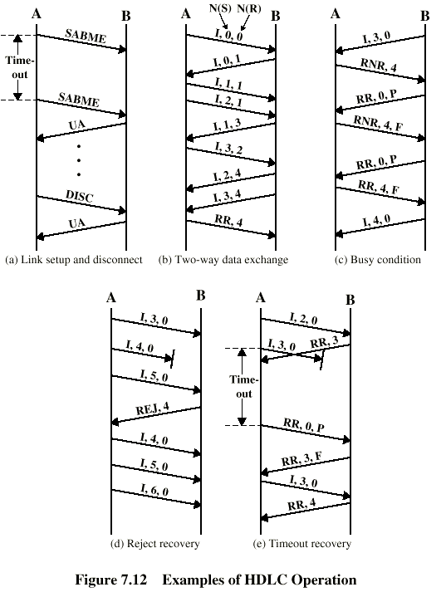
Examples of Operation (1)
.
.
.

Slide 60
Examples of Operation (2)
retransmission

Slide 61
Other DLC Protocols (LAPB,LAPD)
Link Access Procedure, Balanced (LAPB)
  Part of X.25 (ITU-T standard data link layer protocol)
  Subset of HDLC - ABM (Async. Balanced Mode)
  Point to point link between user and packet switching network node
  HDLC frame format
Link Access Procedure, D-Channel (LAPD)
  Part of ISDN (yet another ITU-T standard)
  ABM
  Always 7-bit sequence numbers (no 3-bit)
  always 16-bit CRC
  16-bit address field

Slide 62
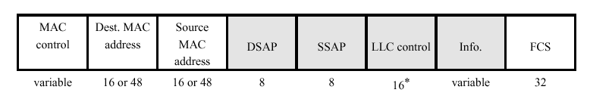
Other DLC Protocols (LLC)
Logical Link Control (LLC)
  IEEE 802 standard
  For LANs (Local Area Networks)
  Link control split between medium access control layer (MAC) and LLC (LLC is on top of MAC)
  Different frame format
    Two addresses needed (sender and receiver) – actually at MAC layer
    Sender and receiver SAP addresses (at LLC layer)
    Control field is same as HDLC (16-bit version for I and S frames; 8-bit for U frames)
  No primary and secondary - all stations are peers
  Error detection at MAC layer
    32 bit CRC

Slide 63
Other DLC Protocols (LLC)
LLC Services
  3 alternatives
  Connection Mode Services
    Similar to HDLC ABM
  Unacknowledged connectionless services
    no connection setup
    No flow-control, no error control, no acks (thus not reliable)
    good to be used with TCP/IP. Why?
  Acknowledged Connectionless Service
    No connection setup
    reliable communication

